Slide 1
Data collection from twitter
Group 9
Abigail Albuquerque, Aria Yan, Isabel Herrero Estrada, Megan Sin, Sandra Phan
Notes:
Hello everyone! We are group 9.

Slide 2
OUR TOPIC OF INTEREST
THE SUPER BOWL!
NFl
Coming soon! February 13th, 2022
Notes:
For this case study, we chose to run analysis on the superbowl. The superbowl is one of the biggest sporting events in the United States. The NFL’s 2021 superbowl had a viewership of over 96 million. Since the superbowl is coming up in about two weeks, we thought it would be interesting to see what people on twitter were talking about and looking forward to regarding the game.

Slide 3
SAMPLING DATA
300
TWEETS COLLECTED
5367
WORDS IN TOTAL
Notes:
For our sample data, we collected 300 tweets in total, having a total of 5367 words.

Slide 4
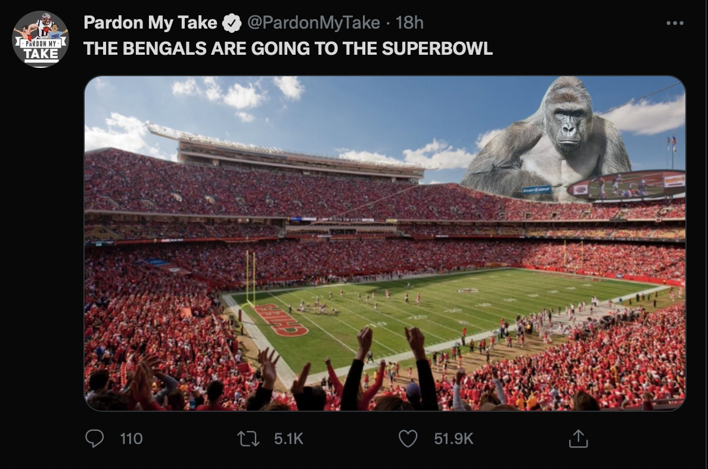
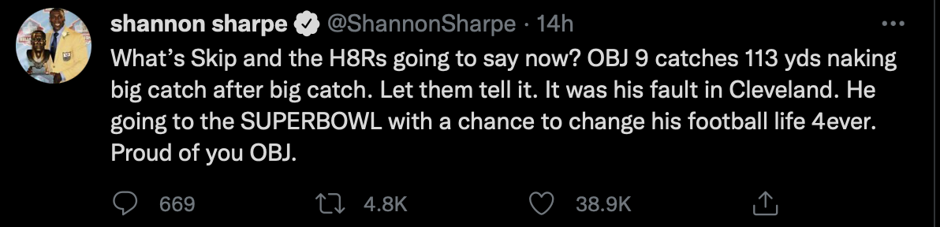
THE TOP 10 TWEETS
#1
#2
Notes:
Isabel Most retweeted

Slide 5
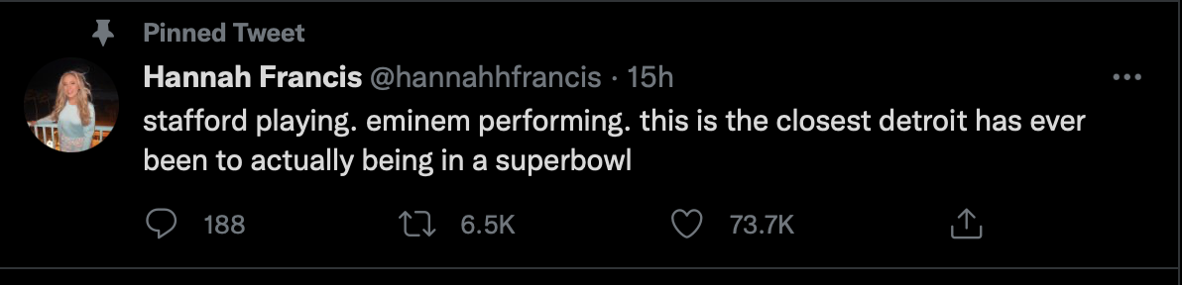
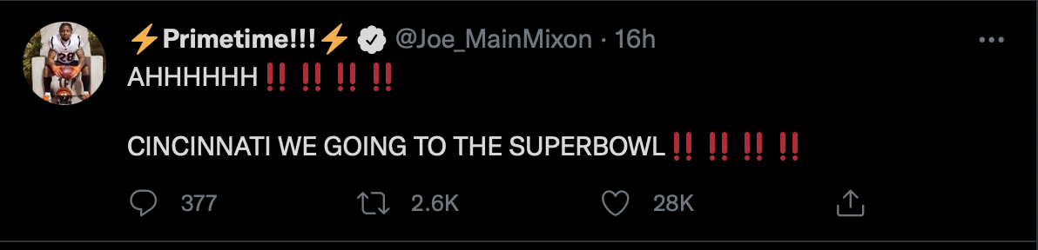
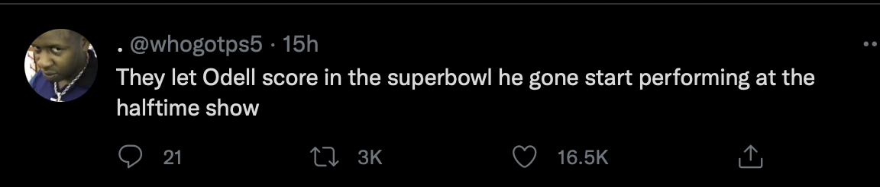
#3
#4
#5
Notes:
isabel

Slide 6
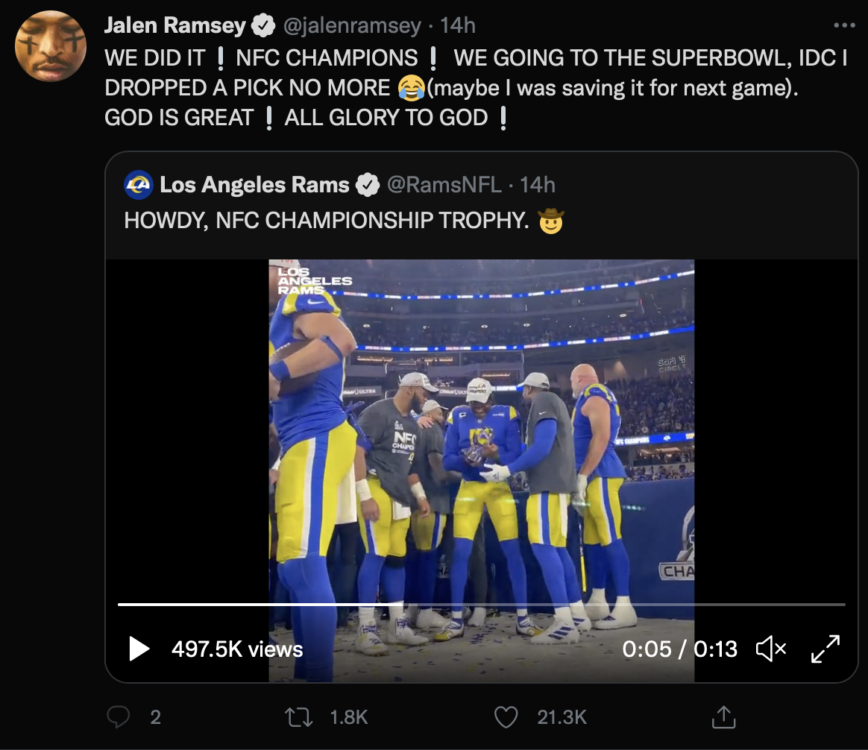
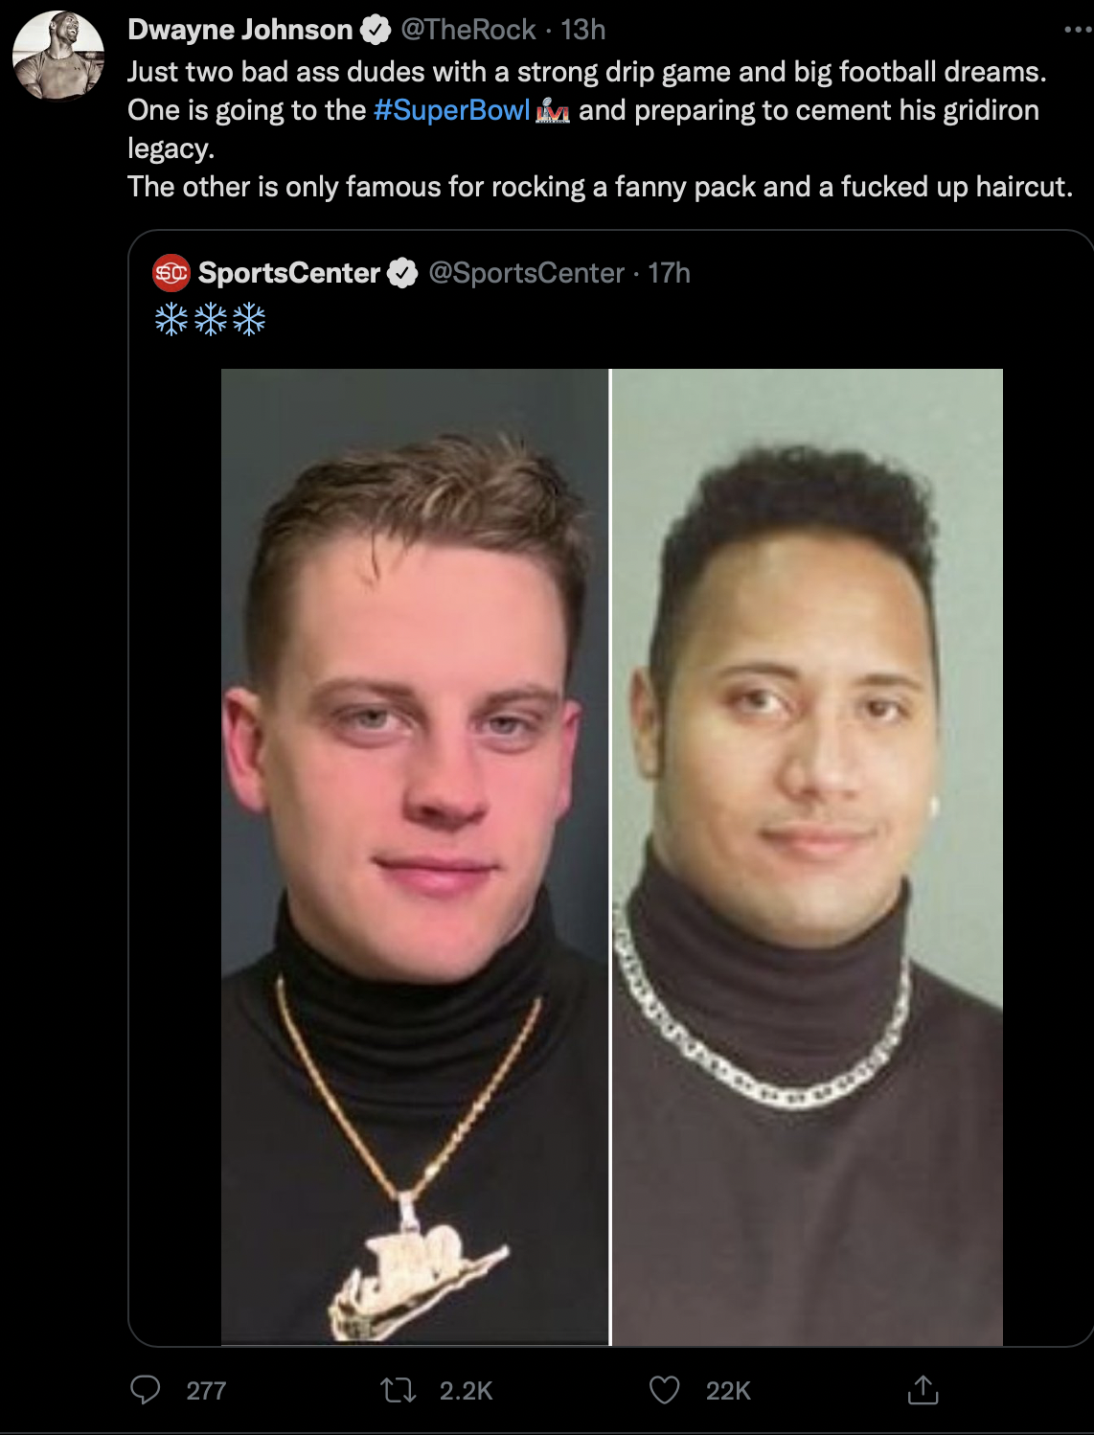
#6
#7
Notes:
isabel

Slide 7
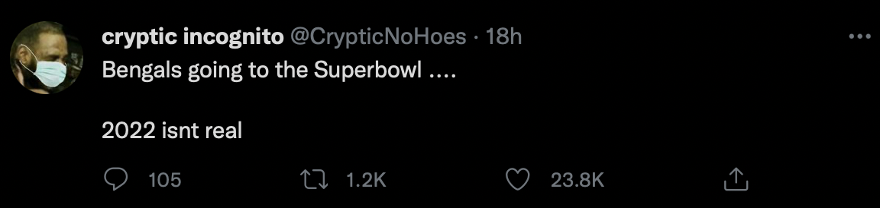
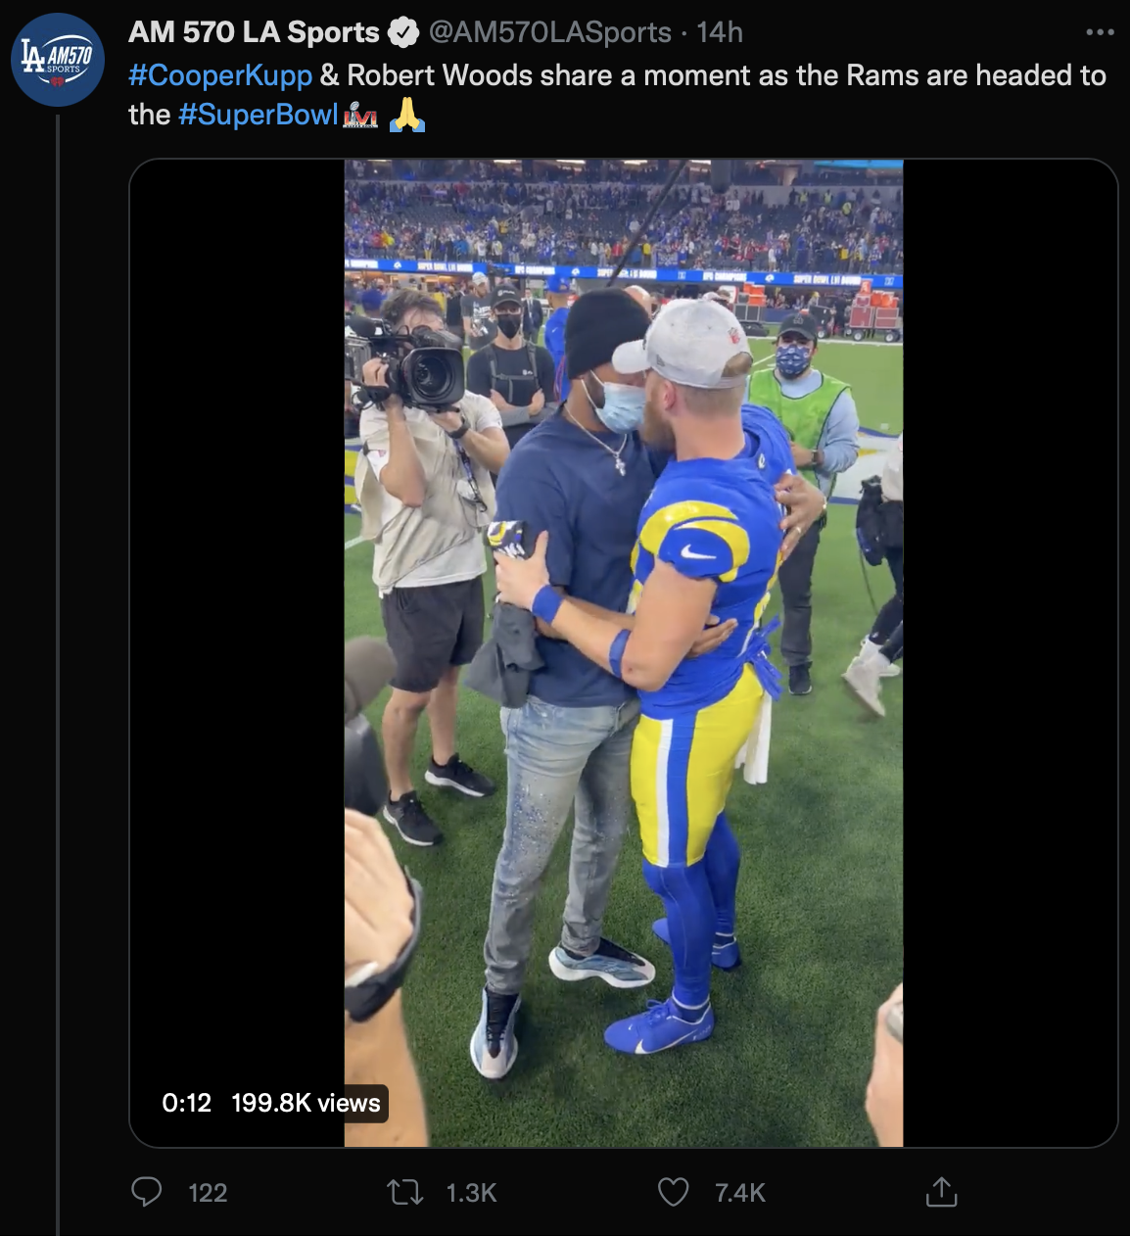
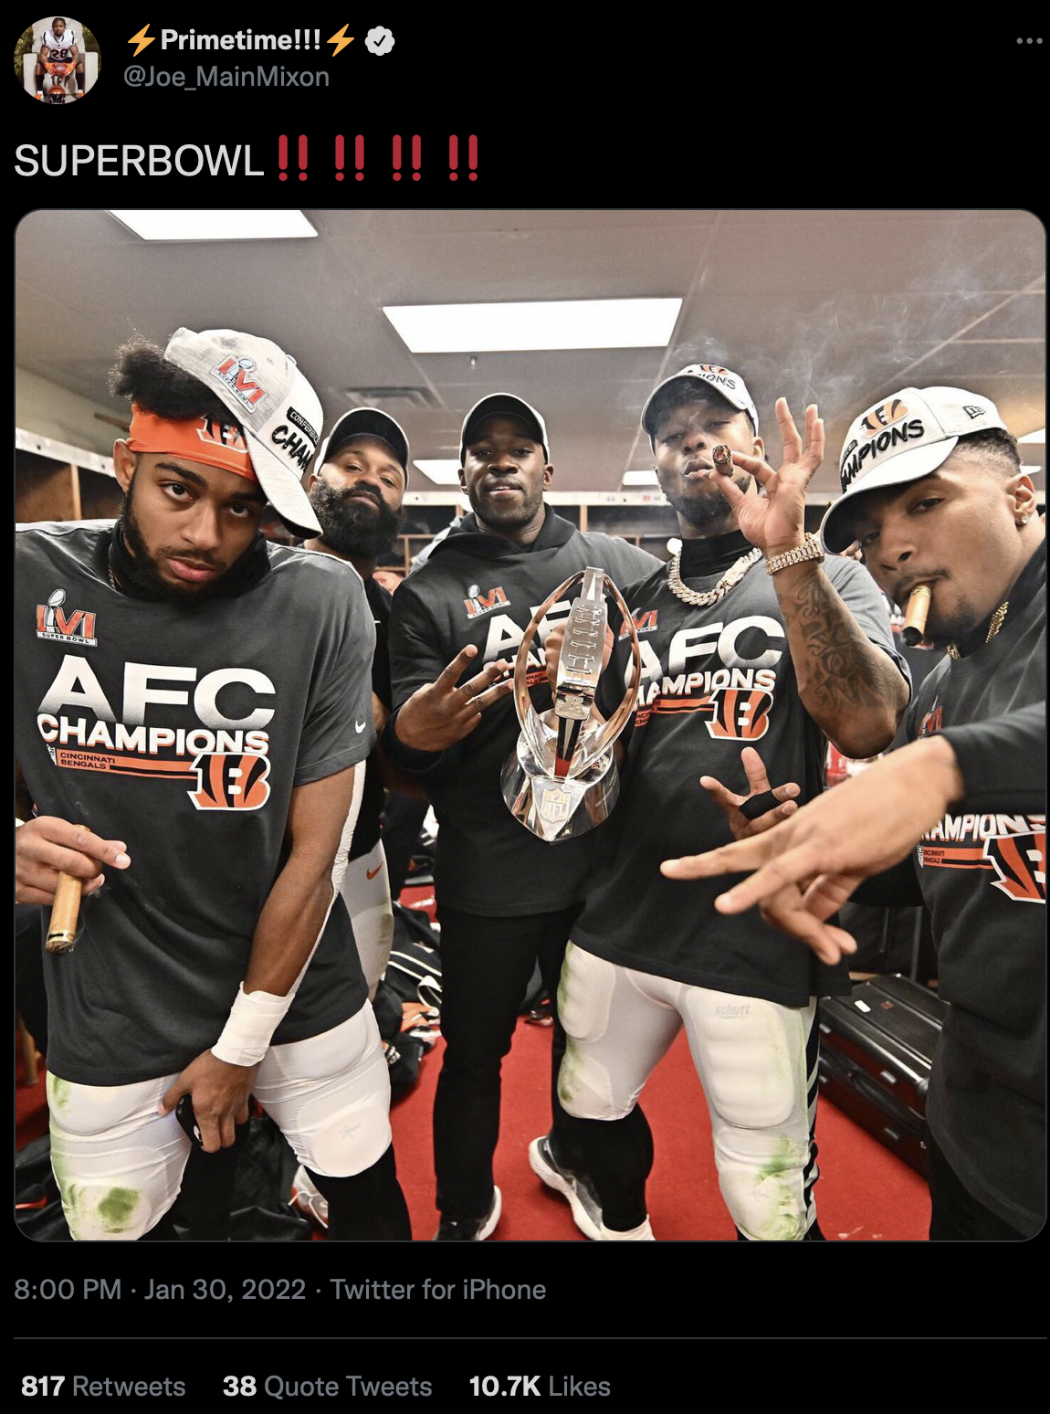
#8
#10
#9
Notes:
isabel

Slide 8
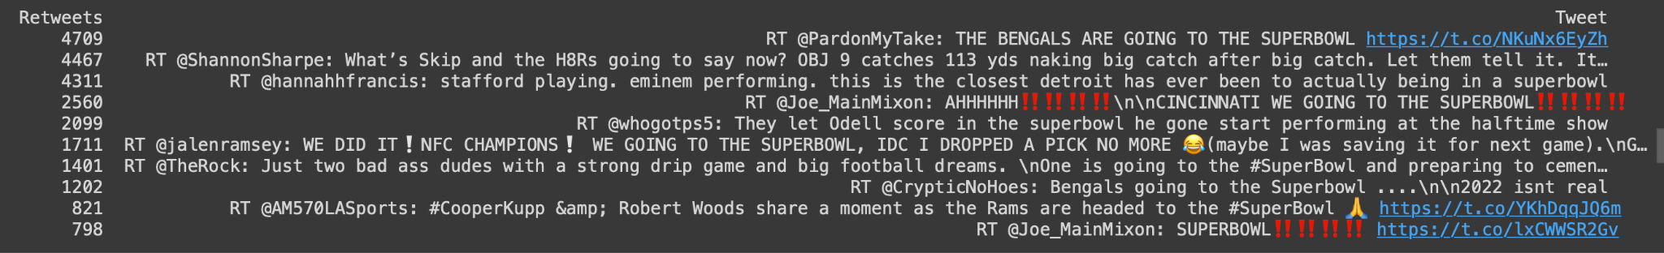
THE original numbers
Notes:
The number of retweets has increased since we collected the data by a noticeable amount. This is fairly useful for finding potential viral tweets
-aria

Slide 9
ANALYZING TWEETS AND TWEET ENTITIES using frequency analysis
Frequency | Words
204 | rt
123 | superbowl
82 | #superbowl
59 | stafford
56 | detroit
55 | going
55 | actually
54 | playing.
54 | performing.
54 | eminem
Frequency | Words
54 | closest
54 | @hannahfrancis:
45 | big
39 | let
24 | bengals
23 | odell
22 | score
22 | halftime
21 | start
21 | performing
Frequency | Words
21 | gone
21 | @whogotps5
20 | rams
15 | what’s
15 | now?
15 | just
15 | game
15 | catches
14 | yds
14 | time
Notes:
Cleaned a little bit - all lower case, could’ve also cleaned punctuation in retrospect
stafford playing. eminem performing. this is the closest detroit has ever been to actually being in a superbowl - all from one from viral tweet and its retweets @hannahfrancis

Slide 10
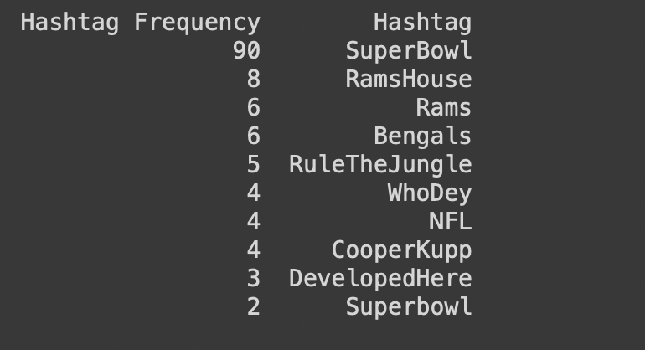
THE TOP 10 hashtags
Notes:
-aria

Slide 11
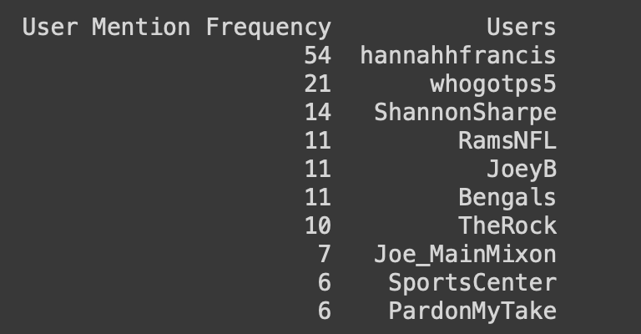
The top 10 mentions
Notes:
-aria, mix of viral tweets and the official twitters of the rams and the bengals

Slide 12
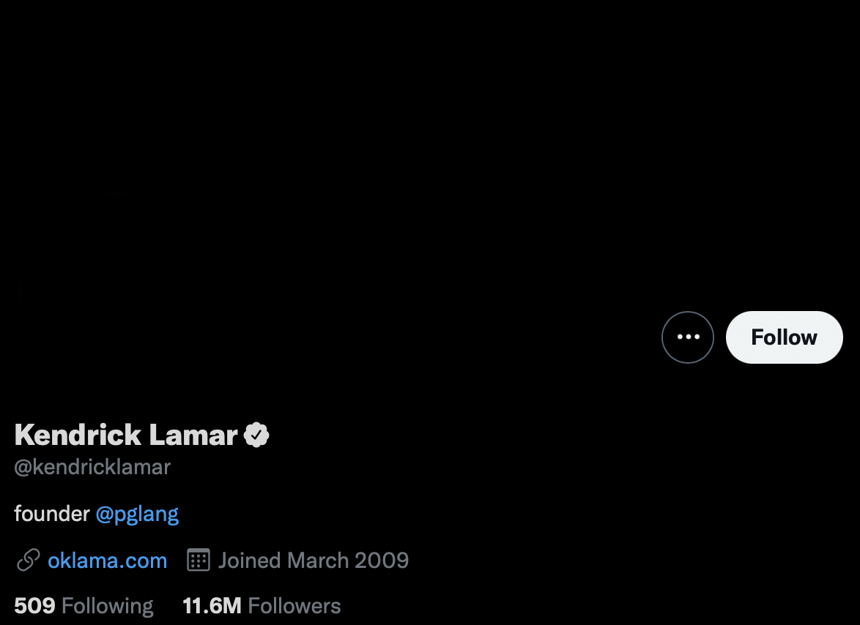
POPULAR TWITTER USER ANALYSIS
POPULAR USER WE CHOSE: Kendrick LAMAR
Notes:
-megan (performing at halftime)

Slide 13
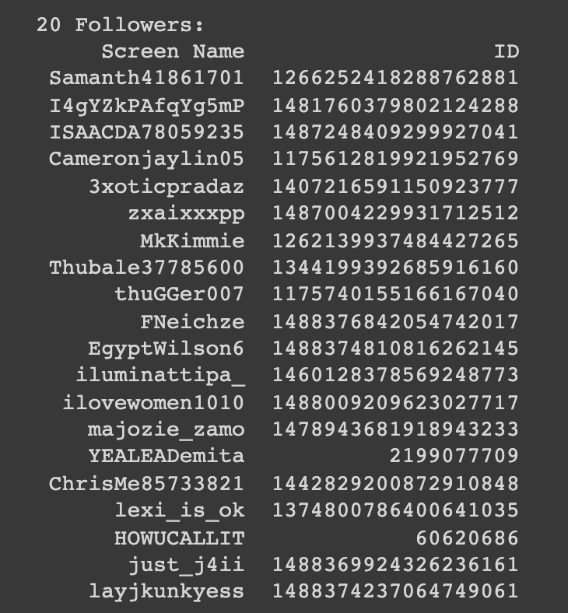
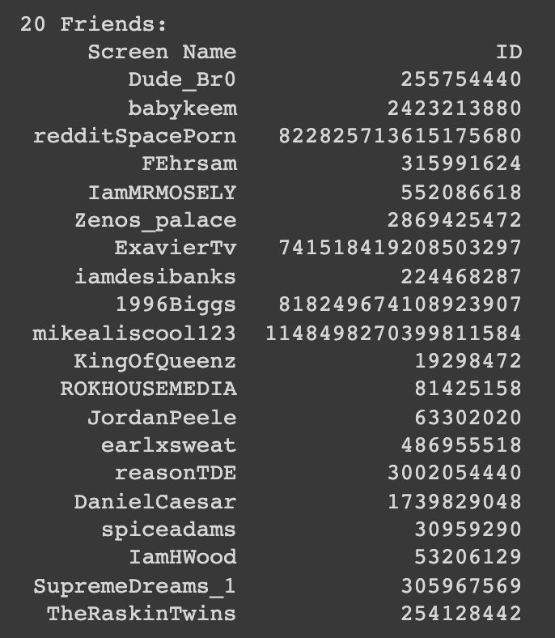
20 followers
20 friends
Notes:
-megan

Slide 14
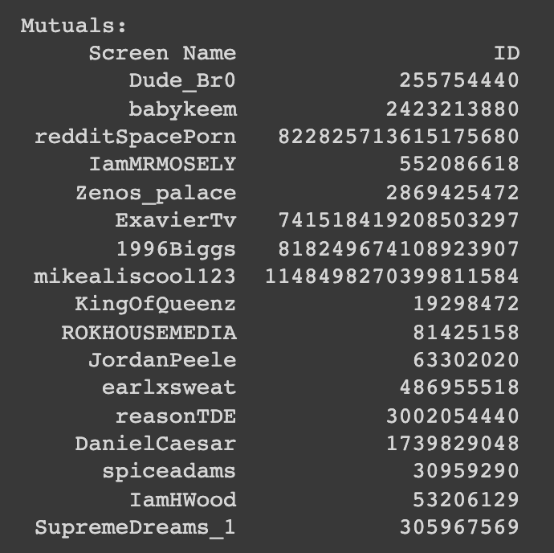
Mutuals
Notes:
-megan
Since the number of people kendrick follows is significantly lower, to get mutuals we essentially looped through the people he follows and checked the friendship status: if they follow him back then they are a mutual. I appended the screen name and id for each friend who followed him back and plotted them in a table.

Slide 15
Our original business question
Based on the tweet density across the us regarding the superbowl, which state is the most excited for the game?
Notes:
We were not able to go ahead with analysis with this question in mind because none of our sample tweets had their geolocation on. So we tweaked our business question.

Slide 16
Our Updated
business question
Which athletes should companies sponsor from each team to promote their products?
Notes:
sandra

Slide 17
CASE DESCRIPTION
How to use this data….?
Fan favorite athletes for commercials
Promote apparel, lifestyle & products through favorite athlete
A step further…identifying sectors (ex: age)
Even more specific targeted ads and product promotion

Slide 18
How could answering this question be beneficial?
Targeted advertisements/commercials with fan favorite athletes to improve sales

Slide 19
Thanks for listening
Do you have any questions?

